Slide 1
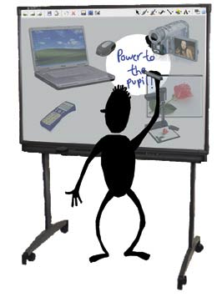

Supporting dialogue using the interactive whiteboard
http://dialogueiwb.educ.cam.ac.uk

Slide 2
OUTLINE
Introduction
Activity 1
Activity 2
Activity 3
Explore the Resource Bank
Lesson planning
More video examples
Ideas for follow-up

Slide 3
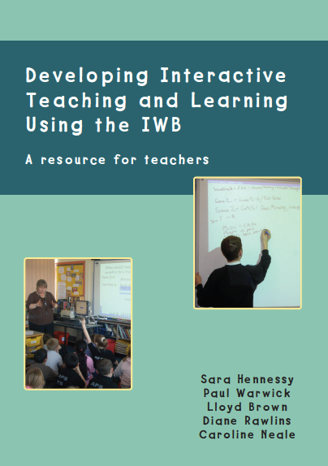
WHAT IS THE PROGRAMME ABOUT?
The activities involve:
Participating in this workshop – engaging with the printed and online resources to guide you in building on what you do now by trying out some new ideas for using the IWB to improve the quality of classroom interaction
Planning and trialling new approaches in your own classroom
Reflecting on what you think has worked well and sharing some examples of what you did
Answering a short survey at the beginning and later on in the programme

Slide 4

DISCUSSION
CLASSROOM TALK AND DIALOGUE
How do you currently use talk in lessons?
How important is focus on talk?
What barriers are there to using talk as a tool for learning?
What do you understand by the term ‘dialogic’ teaching?

Slide 5
What is dialogue?
Dialogue is more than just‘talk’. It
involves teachers and learners commenting and cumulatively building on each other’s ideas, posing questions and constructing interpretations together (Alexander, 2008);
may be sustained over the course of a single lesson or across lessons;
builds on the notion of ‘exploratory talk’ – learners construct shared knowledge and are willing to change their minds and critique their own ideas (Mercer, 2000);
but in the context of IWB use, learners don’t always articulate their reasoning verbally. Dialogue can be non-verbal too!

Slide 6
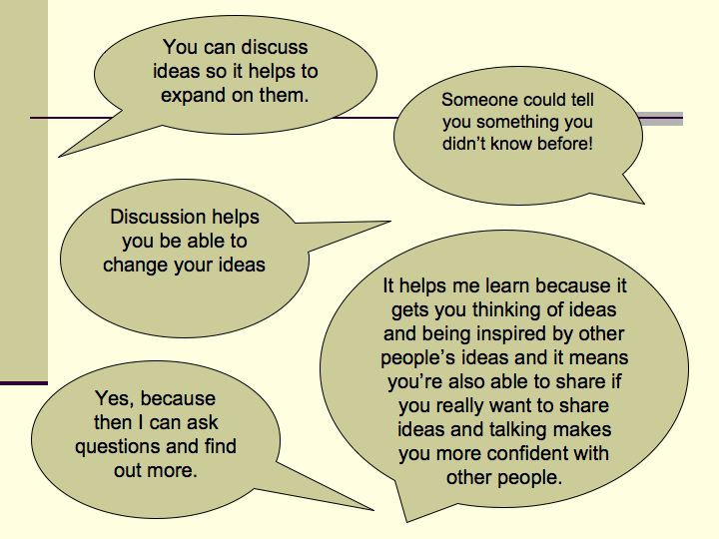
Why is dialogue a good thing?
Notes:
Dialogue can take up lesson time but research confirms its long-term value for student learning, especially reasoning skills but also subject attainment scores.
Importantly, it can lead to longer term change well after the interaction as students reflect further on how ideas are different.
Students in the Cambridge University studies also valued both the IWB and dialogue as tools to enhance learning. Here are some of the things teacher Caroline’s students said about classroom talk.

Slide 7
Dialogue (audit) table

Slide 8
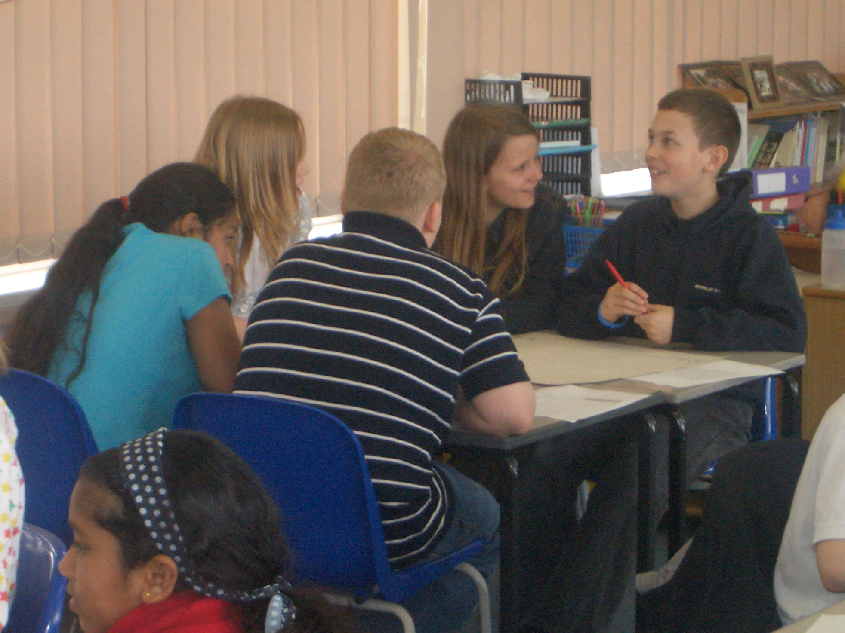
Dialogue in Action
Participants adopt roles and read out the excerpt (pp.8-9).
How does it illustrate dialogue? (Look at the dialogue table for ideas)
Notes:
This excerpt illustrates the idea that dialogic elements of interaction can be woven into broader classroom talk. Notice also that it is not just about what is said by students; the teacher needs to use an inclusive approach and create an atmosphere where children feel safe to contribute their ideas. Although not explicit in this particular excerpt it is certainly implicit.

Slide 9
Look at the Dialogue Table...
For example, supporting classroom dialogue, i.e. ‘dialogic teaching’
means engaging students in articulating, justifying and evaluating their own points of view;
involves teachers in open-ended questioning, feeding in ideas, reflecting and interpreting;
offers opportunities for learners to become the experts and respond to suggestions or questions posed by their peers.
Notes:
Dialogue Table –
However dialogue doesn’t just happen, any more than productive collaboration does when students work in groups. It needs structured guidance from the teacher, and students may need to develop new ways of interacting too.
Expanded Dialogue Table

Slide 10
DOES MY OWN TEACHING SUPPORT DIALOGUE?
You could ‘audit’ your practice using the (expanded) dialogue table.
Do you do some or all of this now?
Look at column 1 again: Is the ethos in your classroom supportive for dialogue? Could you make it more supportive?

Slide 11

WHAT ROLE CAN THE IWB PLAY?
Multimedia
Constructing knowledge together

Slide 12
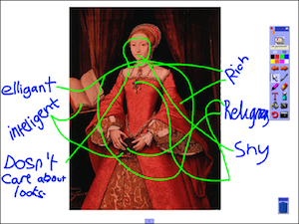
VIDEO EXAMPLE 1
Annotating a portrait of Queen Elizabeth I on the interactive whiteboard
A clip illustrating classroom dialogue in a secondary school history lesson. Students in turn annotated a portrait of the young Queen Elizabeth projected onto the IWB and interpreted their peers’ thinking
Notes:
A powerful clip illustrating classroom dialogue and joint construction of knowledge in a secondary school history lesson. Students in turn annotated a portrait of the young Queen Elizabeth projected onto the IWB and interpreted their peers’ thinking. http://sms.cam.ac.uk/media/1085166.
Pause at 3:43 before peers interpret others’ ideas…
More info: This 9-minute clip [T-M 1.2] depicts students aged 13-14 in turn annotating a digital photograph of a historical portrait (of the young Queen Elizabeth I) projected onto the IWB. It shows how learners were required to interpret their peers’ thinking by drawing links between features of the image and descriptive labels around the picture that others had already written without comment. This activity developed a collective, enhanced understanding of the “Golden Age” of Elizabeth and it also maximised the number of students that could interact directly with the portrait. The teacher Lloyd then built upon the students’ interpretations in the plenary discussion by subtly helping them to understand Elizabeth’s motives and subsequent events. He created continuity of dialogue over time by comparing the portrait with a previously displayed one of the older Elizabeth. He questioned the ‘reality’ portrayed by any historical artefact, concluding both that pictures only tell a partial story and that his own ideas had been changed by the activity. In this democratic classroom, the teacher was also a learner.

Slide 13

Using an image and recording and playing back students’ views

Slide 14
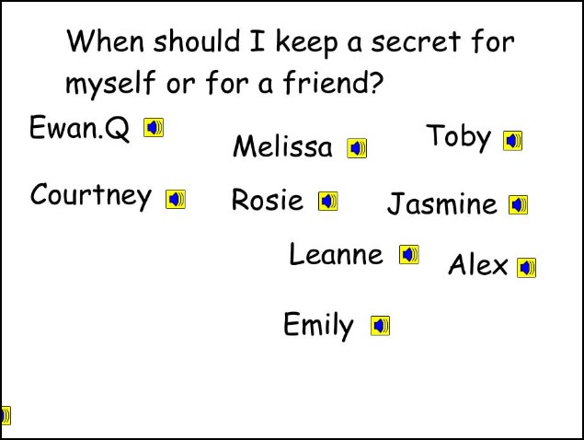
VIDEO EXAMPLE 2
Using open-ended prompts on the interactive whiteboard and children’s recorded voices to stimulate discussion
A clip from a primary school lesson on keeping secrets, illustrating use of open-ended prompts, an image and audio recordings by children (aged 10), to stimulate discussion.
Notes:
More info: This 3-minute clip [D1.1] shows an introduction to the whole issue of keeping secrets. Teacher Diane uses a single image to stimulate some initial discussion, with a ticker-tape ‘core’ question streaming across the screen. She then uses sound files, recorded before the lesson, to give the children ‘another voice’ through which they can express their ideas and which can then act as a stimulus for continuing dialogue. This is another way of sharing views orally. It is easiest to do using the IWB’s own audio recording facility – even young primary children can operate this themselves – but can be done using a portable digital audio recorder too. Playing pre-recordings of students’ opinions is an effective stimulus for class dialogue – it pre-packages the information for discussion, and forces students to respond to each other. Audio files can be embedded in the flipchart so they can easily be clicked on to play in succession.

Slide 15
How did the teachers portrayed support dialogue?
How did they weave the use of the IWB into the lesson activities?
Discuss how useful/feasible these activities and strategies are in your own setting.

Slide 16
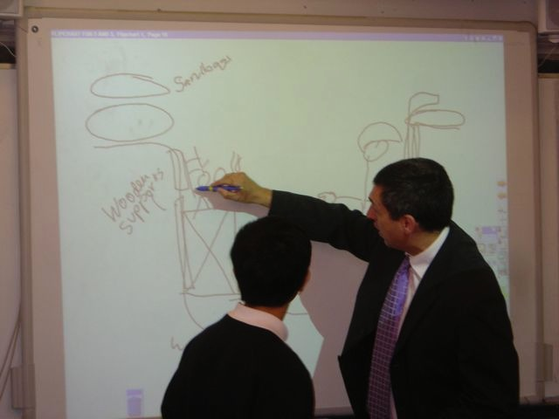
ONLINE RESOURCES http://tinyurl.com/OUPIWB
annotated screenshots,
video clips of dialogic classroom practice in which students build knowledge together,
IWB software templates for lesson activities
Dialogue tables, school action plan etc.

Slide 17
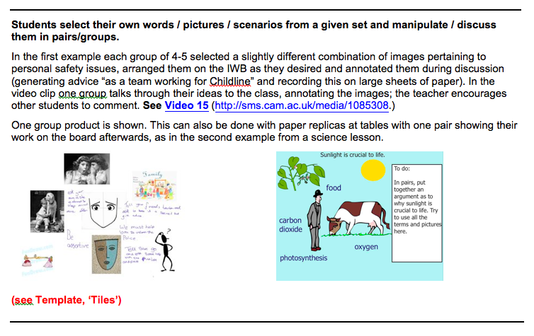
Resource Bank
Notes:
Show video from 5.40-8.02

Slide 18
Highlighting, underlining, circling, annotating;
recording a teacher voiceover

Slide 19
Class brainstorm

Slide 20
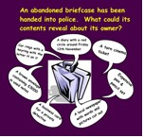
Stimulating discussion and ideas for writing

Slide 21
Focusing attention using spotlight, magnifier or ‘cover and reveal’

Slide 22
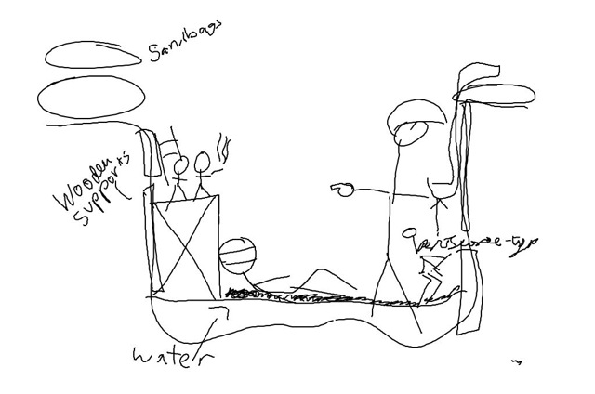
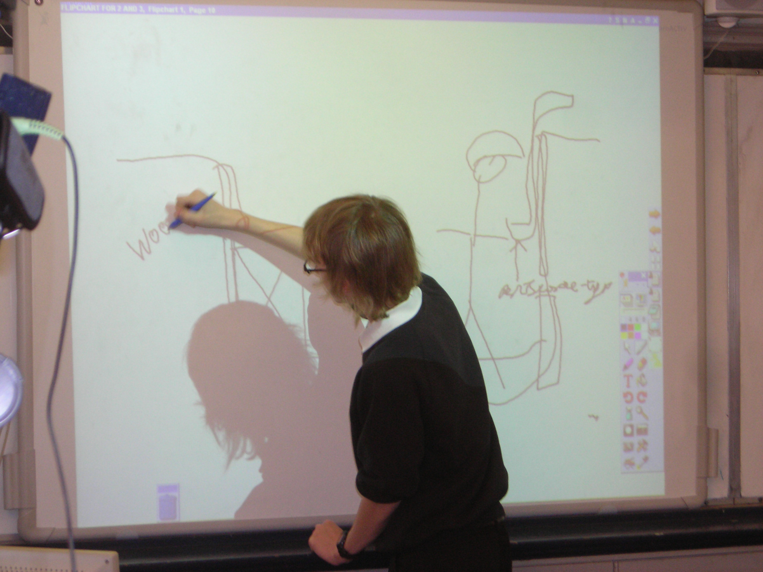
Drawing objects on the IWB together

Slide 23
Revisiting

Slide 24
Arranging or matching to show understanding

Slide 25


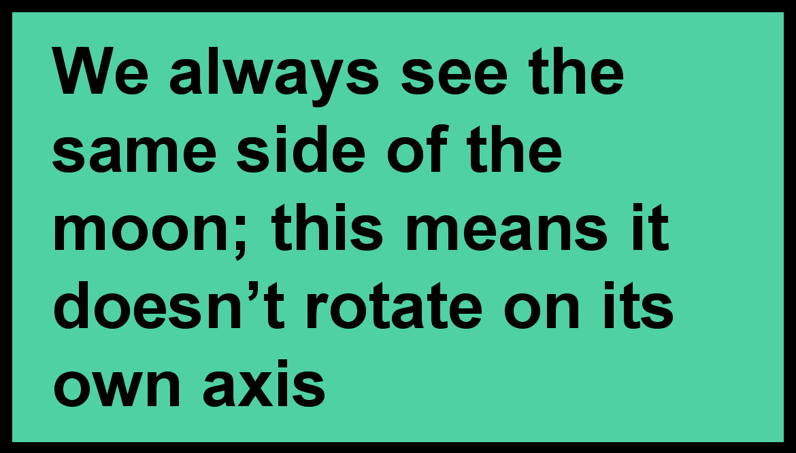

Square of truth or magic box/window: The moon of truth

Slide 26
The moon of truth

Slide 27
The moon of truth

Slide 28
THINK ABOUT AN UP AND COMING LESSON OF YOUR OWN…
Explore the ’Resource Bank’ and collection of video clips
Are any of these ideas useful to you?
What other applications of them can you think of?
What might be effective with your particular students?

Slide 29
LESSON PLANNING
Think about what you have seen today and choose some aspect to try out in your classroom
Plan a lesson or a lesson activity suitable for your students
How can you build in response to others?

Slide 30
VIDEO EXAMPLE 3
Group interaction at the interactive whiteboard: food chains
A clip illustrating a group interaction at the interactive whiteboard. Students modelled some of the features of classroom dialogue demonstrated by their teachers e.g. changing their mind and checking for agreement/disagreement.

Slide 31
VIDEO EXAMPLE 4
Dialogue after interactive whiteboard use in a secondary history class
This clip illustrates the rich dialogue that ensued when the teacher posed the question ‘Is it possible for us to imagine the experience of trench warfare?’ after using a variety of multimedia resources on the interactive whiteboard in the previous two lessons.

Slide 32
DISCUSSION
- How did the clips illustrate the use of the IWB for supporting dialogic teaching?
-
- Discuss how useful/feasible these activities and strategies are in your own setting.

Slide 33
FOLLOW UP
Promoting dialogue across the school?
RESOURCES
Creating a climate for dialogue
Teacher strategies for supporting dialogue with the IWB
Engaging all students in IWB activity
Peer observation
Reflection – learning outcomes etc
Recording – teacher and students
Sharing your ideas with other teachers
Notes:
Engaging all students in IWB activity – How can you get all students to participate, including those who don’t get a chance to come up to the IWB in the lesson?
Are there opportunities for other input or feedback when one student is at the board? Would individual or pairwork on mini-whiteboards or in exercise books be useful here?

Slide 34
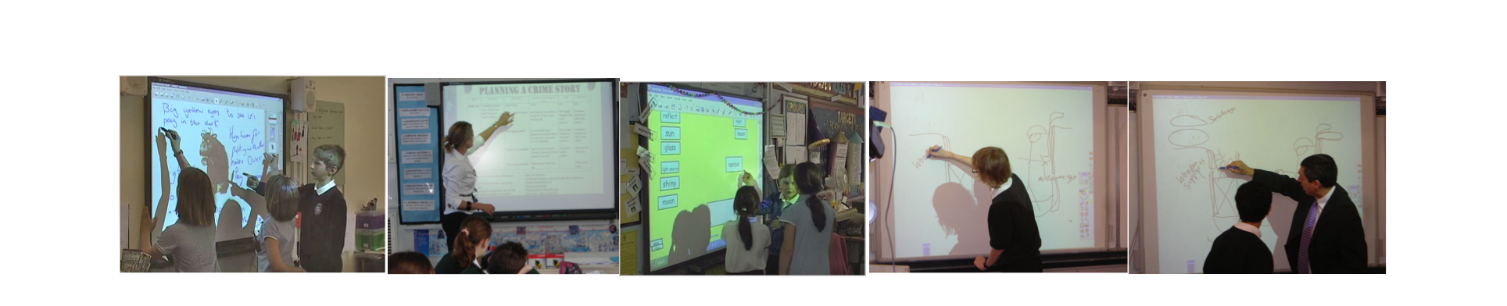
THANK YOU FOR YOUR ATTENTION!
Sara Hennessy sch30@cam.ac.uk

